Slide 1




AIRLINE OPERATIONS ANALYSIS
FINAL PROJECT
Author: Nguyen Thi Phuong Trang

Slide 2


INTRODUCTION
This project analyzes an airline dataset to uncover key patterns in passenger demographics, flight performance, and geographic distribution. Through data cleaning, exploration, and visualization, the analysis reveals trends that support data-driven decisions aimed at improving operational efficiency, customer experience, and strategic planning within the aviation industry.
GitHub link: https://github.com/trangntp37/Airline_Analysis
Dataset source: https://www.kaggle.com/datasets/iamsouravbanerjee/airline-dataset/data

Slide 3
TABLE OF CONTENT
1. PROJECT OVERVIEW
5. PASSENGER SEGMENTATION
2. DATASET OVERVIEW
5. DASHBOARD OVERVIEW (POWER BI)
3. DATA PREPARATION & CLEANING
6. KEY INSIGHTS & FINDINGS
4. EXPLORATION DATA ANALYSIS (EDA)
7. BUSINESS RECOMMENDATIONS

Slide 4


1. Project Overview
Context
Airlines generate large volumes of passenger data across different regions and routes, but translating this data into actionable customer insights remains challenging.
Problem
Passenger populations are often treated as homogeneous, limiting the ability to understand demographic patterns and identify meaningful customer groups.
Challenges
Limited behavioral variables in the dataset
High-cardinality categorical features (e.g. nationality, airports)
Potentially pre-processed or synthetic data with low natural variance
Objectives
Analyze passenger demographics and geographic distribution
Identify high-level passenger segments using unsupervised learning
Summarize insights through interactive dashboards
Technology Used
SQL Server (database)
Python (Pandas, Scikit-learn) for data processing and clustering
Power BI for visualization and dashboarding

Slide 5

2. Dataset Overview
Scope: The dataset provides insights into various aspects of airline operations, covering passenger demographics, travel details, flight routes, crew information, and flight statuses.
Number of records: 98,619
Key Columns:
Passenger Information
Flight & Airport Information
Passenger ID
First Name
Last Name
Gender
Age
Nationality
Airport Name
Airport Country Code
Country Name
Airport Continent
Continents
Departure Date
Arrival Airport
Pilot Name
Flight Status

Slide 6
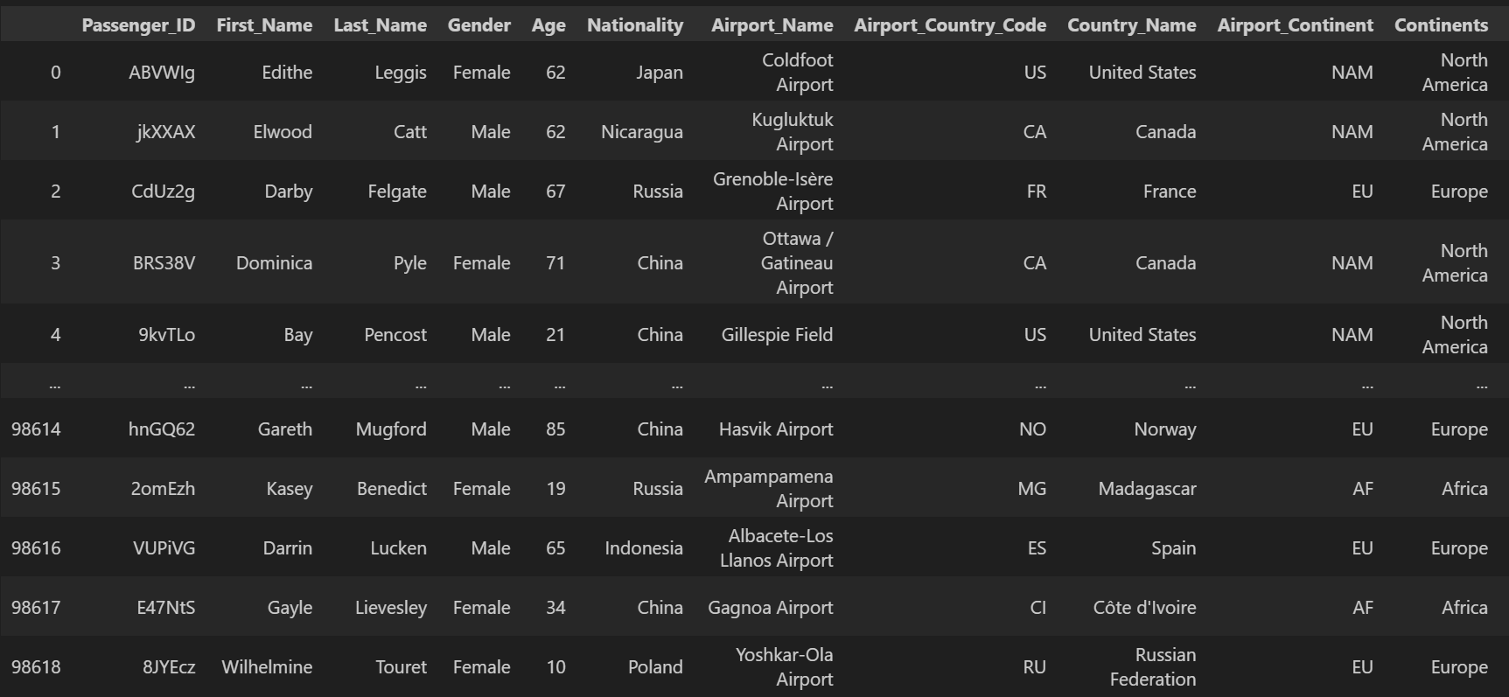
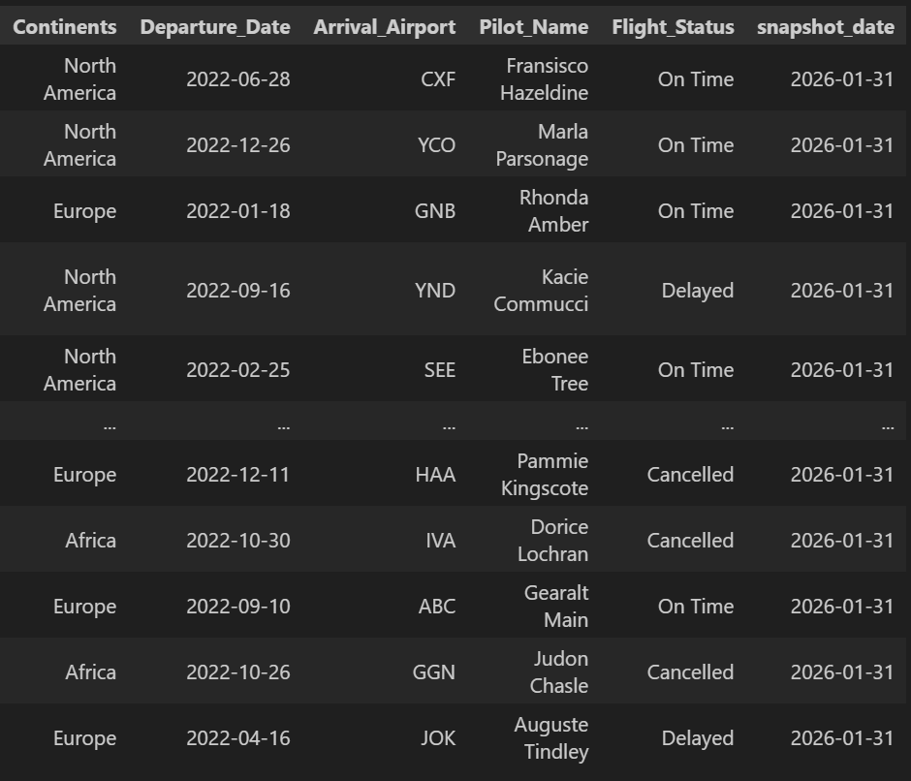
2. Dataset Overview
Data Frame Preview:

Slide 7
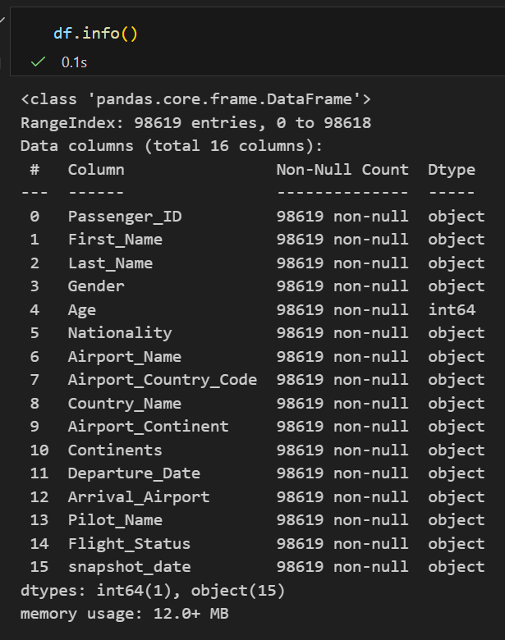
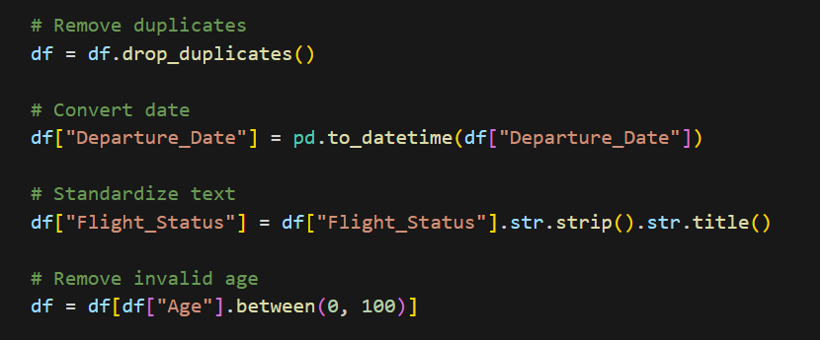
3. Data preparation & Cleaning
The dataset required minimal cleaning, as the raw data was already well-structured, with no missing values, duplicates, or obvious inconsistencies. Most preprocessing focused on feature extraction rather than data correction.

Slide 8
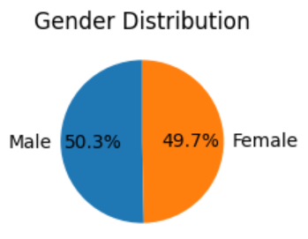
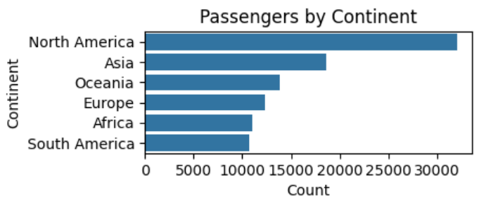
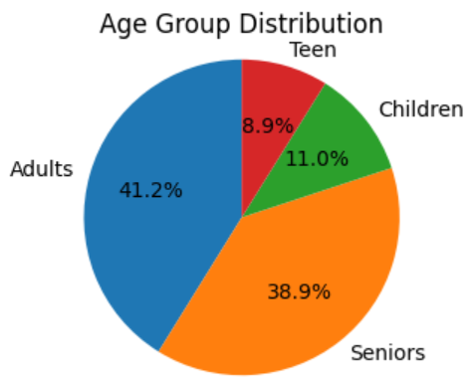
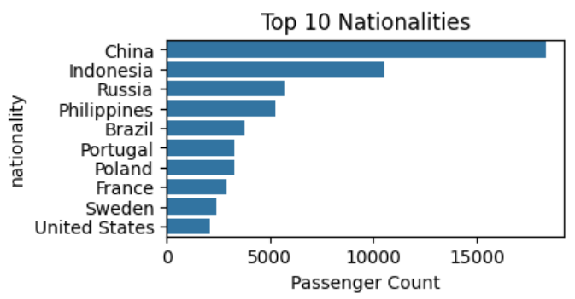
4. Exploration Data Analysis (EDA)
Passengers Demographic
Passenger gender distribution is nearly balanced, indicating no strong gender bias in travel demand.
Adults and seniors dominate the passenger base, while children and teens form a smaller share.
North America and Asia lead in passenger volume, reflecting strong travel demand.
Passenger traffic is concentrated among a limited number of nationalities, with China as the top contributor.
Overall, the demographic profile points to a stable, mature customer base focused on key regions and markets.

Slide 9
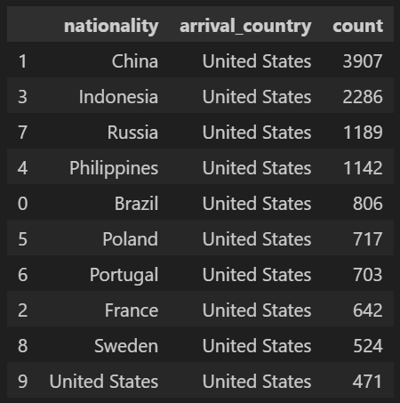
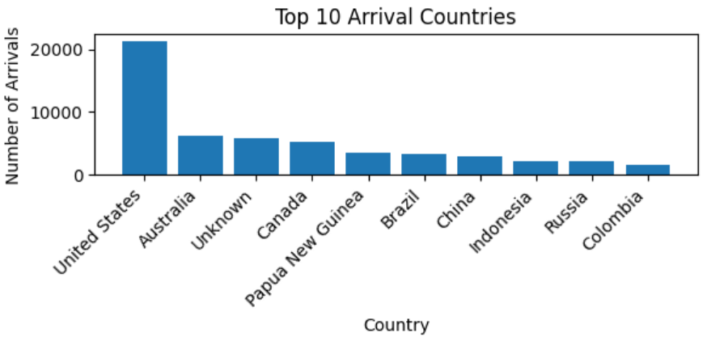
4. Exploration Data Analysis (EDA)
Geographics
The United States receives the highest number of arriving passengers, with a figure more than three times higher than that of the second-ranked country, Australia.
Top Nationality to United States

Slide 10
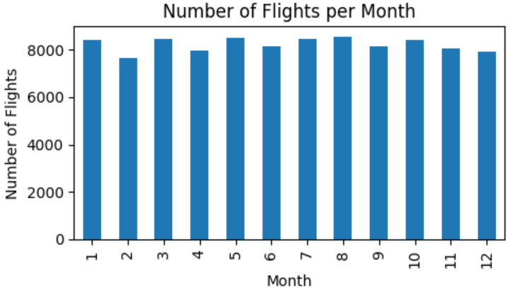
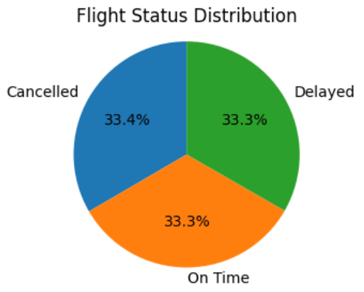
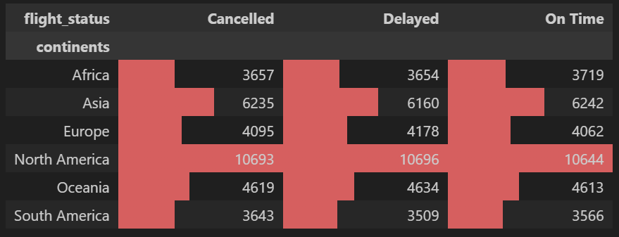
4. Exploration Data Analysis (EDA)
Flights Operations
A high proportion of problem flights (68%) is observed. However, unlike real-world airline data—where on-time flights typically dominate—the balanced status distribution indicates limited realism, reducing the usefulness of this metric for operational decision-making.
Monthly flight volumes remain largely stable throughout the year, with a slight dip observed in February.

Slide 11
5. Passenger Segmentation
Objective
Segment passengers using demographic and geographic features to identify high-level customer groups.
Data & Method
Features: Age, Gender, Nationality, Departure Country, Arrival Airport
Applied K-Means clustering (K = 2) after encoding and standardization
Output
Each passenger assigned to a customer segment
Segment profiles created based on dominant attributes and passenger volume
Metric | Segment 0 | Segment 1 | Key Insight
Avg Travel Frequency | 1 | 1 | No difference
Dominant Age Group | Seniors | Adults | Main differentiator
Dominant Nationality | China | China | Identical
Top Destination | United States | United States | Identical
Passenger Count | 47,736 | 50,883 | Balanced distribution

Slide 12
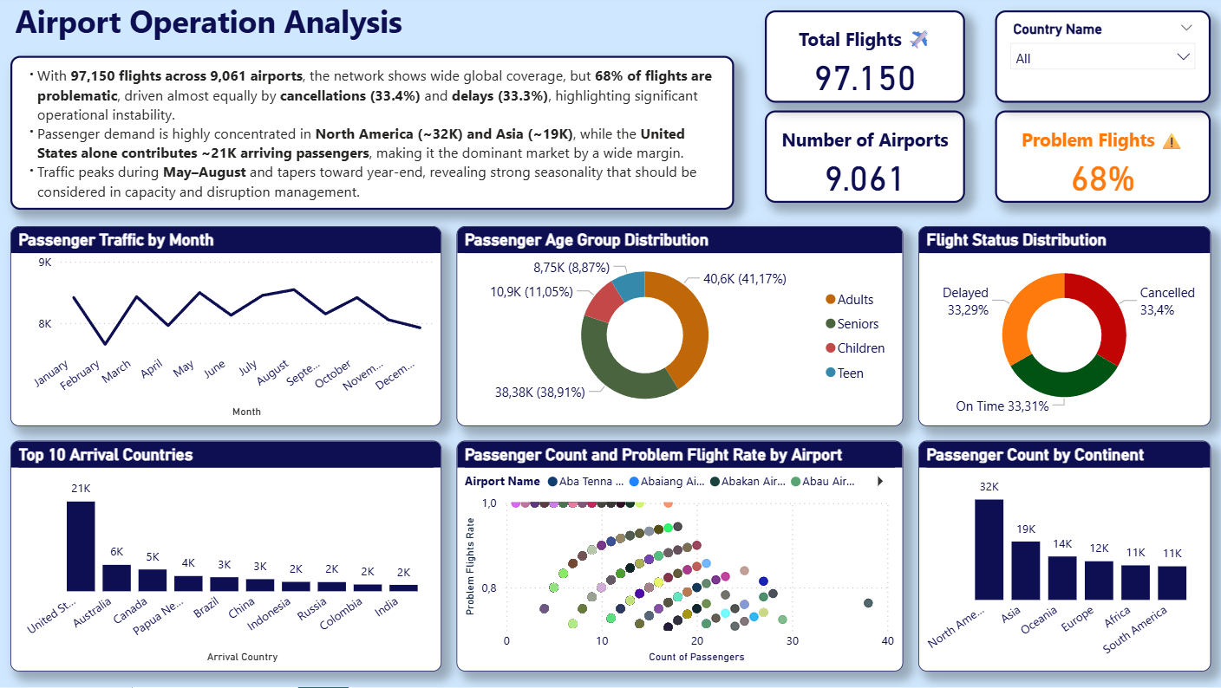
5. Dashboard Overview (Power BI)
Dashboard Overview
This dashboard provides a high-level overview of flight operations across time and geography.
Key questions addressed
What is the distribution of flight statuses?
How does flight volume change across months?
How are flight outcomes distributed by continent?
Key visuals
Flight status distribution
Monthly flight volume
Flight status by continent
Note: Due to the balanced nature of the dataset, findings should be interpreted as illustrative rather than representative of real airline performance.

Slide 13
6. Key Insights & Findings
Passenger & Geographic Distribution
The network covers 97,150 flights across 9,061 airports, indicating broad global coverage.
Passenger demand is concentrated in North America (~32K) and Asia (~19K), with the United States emerging as the dominant arrival country.
Other continents contribute more evenly distributed but smaller passenger volumes, suggesting limited geographic skew beyond major hubs.
Demographic Composition
Adults and seniors account for the majority of passengers, together representing nearly 80% of total traffic.
Children and teens form a smaller share, indicating a predominantly adult travel population within the dataset.
Flight Operations & Temporal Patterns
Approximately 68% of flights are classified as problematic, driven almost equally by delays (~33%) and cancellations (~33%).
Passenger traffic shows moderate mid-year increases and a softer decline toward year-end, suggesting some seasonality but no extreme peaks.
Problem flight rates remain consistently high across airports, regardless of passenger volume.

Slide 14

7. Recommendation
Improve Operational Reliability
Prioritize initiatives to reduce delays and cancellations, focusing first on high-traffic regions such as North America and Asia, where passenger impact is greatest.
Introduce tighter schedule buffers and contingency planning to mitigate disruption during peak travel periods.
Capacity & Seasonal Planning
Allocate additional resources during mid-year peak months (May–August) to manage increased passenger demand.
Adjust staffing and ground operations toward year-end to maintain service levels as demand tapers.
Airport & Network Optimization
Monitor airports with high problem-flight rates, even at moderate passenger volumes, to identify operational bottlenecks.
Strengthen coordination with major hub airports, particularly in the United States, to reduce network-wide disruption.
Passenger-Centric Strategies
Enhance communication and rebooking support for adult and senior travelers, who represent the majority of passengers.
Offer targeted compensation or service recovery programs to retain customer trust during service disruptions.

Slide 15


THANK YOU!

